Slide 1


ANALYSIS OF STUDENTS
PERFORMANCE USING
PYTHON
Presented By: Saba Zaman
Supervisor: Ma’am Hina Javed
BSCS 7th A | Department of Computer Science
Federal Urdu University of Arts, Science & Technology, Islamabad

Slide 2
ABSTRACT
This project analyzes a dataset of student performance in Math, English, and Science.
The goal is to understand the distribution of scores, identify any gender disparities, and provide actionable insights.
The analysis involves data acquisition, cleaning, statistical summarization, and visualization.

Slide 3

INTRODUCTION: ELEVATING EDUCATIONAL QUALITY THROUGH DATA
Understanding student performance is fundamental to improving the quality of education. By systematically analysing academic results, we can pinpoint areas where students excel and, more importantly, identify subjects or topics that require additional support and intervention.
This report specifically focuses on student achievement in three foundational subjects: Mathematics, English Language, and Science. Each subject presents unique challenges and opportunities for learning, and a detailed examination of performance can inform targeted teaching strategies.
The use of Python programming proves invaluable in this endeavour, offering robust capabilities for data manipulation, statistical analysis, and compelling visualisations. This approach makes complex data analysis more accessible and impactful.

Slide 4


METHODOLOGY: A PYTHON-DRIVEN APPROACH
The project follows a structured data science pipeline:
Data Acquisition:
Loading the dataset from a CSV file (`students_performance.csv`).
2. Data Cleaning:
Checking for and handling missing values and duplicate records to ensure data integrity.
3. Data Analysis:
Computing descriptive statistics (mean, min, max) and grouping data by key variables (Gender).
4. Visualization:
Creating bar charts to visually compare performance across subjects and demographics.
Tools Used:
Python, Pandas (for data manipulation), Matplotlib and Seaborn (for visualization).
.

Slide 5
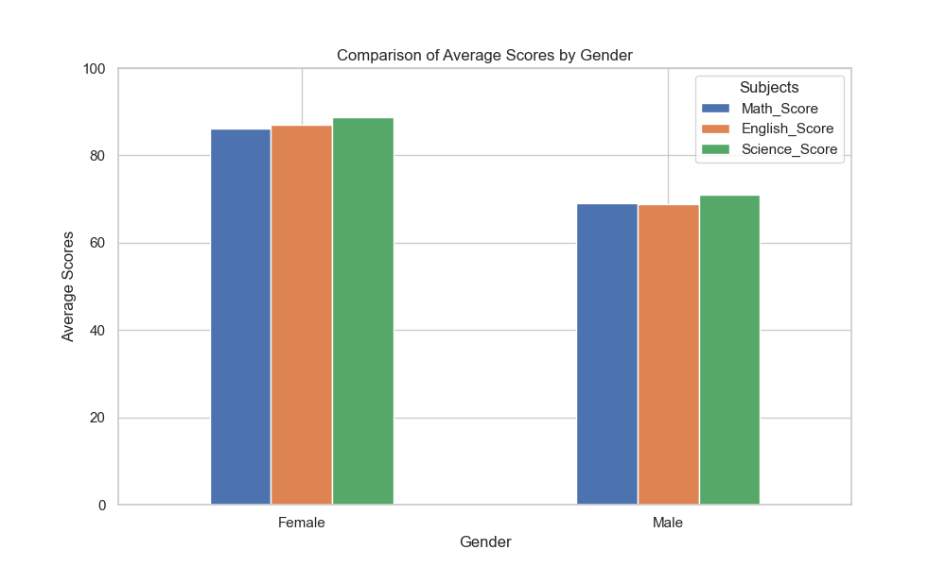
COMPARISON OF SUBJECT PERFORMANCE:
A key part of this analysis was comparing performance based on Gender
Math:
Females (86.2) scored significantly higher than Males (69.0).
English:
Females (87.0) outperformed Males (68.8).
Science:
Females (88.8) also led in Science compared to Males (71.0).
I

Slide 6
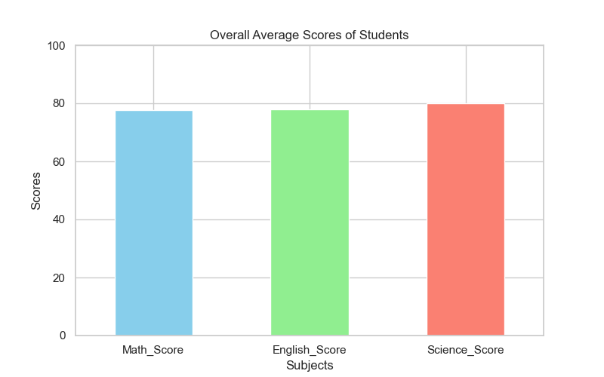
RESULTS
overall Performance: The average scores across all students were Math: 77.6, English: 77.9, and Science: 79.9.
Gender Differences: Females consistently performed better than Males across all three subjects.
Visualizations
`average_scores.png`: Shows the average score for each subject.
`gender_comparison.png`: Highlights differences between Male and Female students.
(Graph showing average scores in Math,English, and S ciense)

Slide 7

CONCLUSION: DATA-DRIVEN EDUCATION FOR THE FUTURE
The analysis provides a clear overview of student performance. Results indicate that Female students outperformed Male students in all subject areas within this dataset. This suggests that while the overall average is satisfactory, male students might benefit from additional support. Future work could involve analyzing other factors like study time or attendance if such data were available.

Slide 8

REFERENCES
Kaggle Student Performance Dataset: https://www.kaggle.com/code/znielsen/analysis-and-prediction-of-student-performance
Python Pandas Documentation: https://pandas.pydata.org/
Matplotlib Documentation: https://matplotlib.org/
Analytics Vidhya Guide on Student Performance Analysis: https://www.analyticsvidhya.com/blog/2023/04/student-performance-analysis-and-prediction
Github Repository ink:https://github.com/saba722279/Students-Performance-analysis

Slide 9

THANK YOU
QUESTIONS & DISCUSSION
We welcome your questions and any further discussion on this analysis.
Contact: saba.zaman.waada@gmail.com

